Slide 1
Consensus and Discord during the Cold War
Discord began during Vietnam War, based on news coverage, economy, civil rights movement and protests, large losses of life, and Nixon administration
Vietnam Syndrome developed: U.S. public does not favor military intervention unless completely necessary
Carter presidency focused on international human rights and democracy but was plagued by world events and Iran hostage situation
Reagan found support for defense buildup but lost support for interventions based on problems in Central America
George H. W. Bush used strong and quick military for Persian Gulf War with Iraq—fast war pleased public and Bush questioned Vietnam Syndrome
Notes:
Learning Objective number: 7.2

Slide 2
Public Ambivalence in the “New World Order”
After Cold War, public and government had considerable ambivalence regarding foreign affairs
No definite positions or consensus on issues
Public identified “don’t know” as biggest foreign policy problem
Attention focused on economic growth
Lack of grand strategy by Clinton administration (throughout the 1990s)
Public against interventionism, but in favor of multilateral diplomacy, UN efforts, and Foreign Aid
Notes:
Learning Objective number: 7.2

Slide 3
iclicker question:
The idea that policymakers invent or create international conflict to distract the population from domestic problems is called:
A. Rally around the flag effect
B. war-mongering
C. Diversionary conflict theory
D. Diversionary war theory
E. None of the above

Slide 4
Rally around the Flag after 9/11
Public concerns about terrorism, security, and the Middle East after 9/11 attacks
Public rallies around the president and other officials during times of crisis
Diversionary theory of war: Suggests that officials can benefit from crises and sometimes even desire them
Bush’s approval rating jumped following 9/11: Peaked at highest rating enjoyed by any president
Public, in turn, supported antiterrorism (U.S. PATRIOT Act)
Public granted early approval of Afghanistan invasion
Notes:
Learning Objective number: 7.2

Slide 5
The Anti-American Backlash
2001–2007
From 2001 to 2006, U.S. public approval of Bush fell from high of 90% to 30%
In 2005, 90% of Americans polled thought showing more respect for the views and needs of other countries would increase security
In 2006, citizens in 33 of 35 countries perceived terrorism was more likely
In 2007, approximately 2 out of 3 Americans thought the war in Iraq was not going well
Still, the U.S. continued to receive support from the Philippines, Japan, and Eastern Europe
Notes:
Learning Objective number: 7.2

Slide 6
Foreign Policy Renewal & Fatigue in the Obama Era
New priorities in 2008
Top priority for Americans was improving America’s world standing
Next two priorities: Jobs and access to energy
Obama’s foreign policy agenda
(1) Diplomacy; (2) Multilateral cooperation; (3) International law; (4) International institutions.
Recent developments fuel public’s sense of foreign policy fatigue
Arab Spring
Power plays by Russia, China
Rise of the Islamic State
Notes:
Learning Objective number: 7.2

Slide 7
What do Americans really want?
A prevalent contradiction in the way that public opinion interacts with U.S. foreign policy:
While most Americans favor international withdrawal and a focus on domestic issues, a majority (56%) also believes that the Obama administration did not do enough to fight the Islamic State, and that American standing and power in world affairs are important.
What to do about that?

Slide 8
The View from Overseas
Growing impact of international public opinion
Advanced technologies
Widespread growth of civil societies in response to domestic reforms
Transnational issues
2012: Upswing in international public support for U.S.
Better perceptions of U.S. in European countries, China, Japan, Mexico
Negative majorities remain in Middle East, Turkey, Russia
2016: Major down-turn since advent of Trump administration
Notes:
Learning Objective number: 7.2

Slide 9
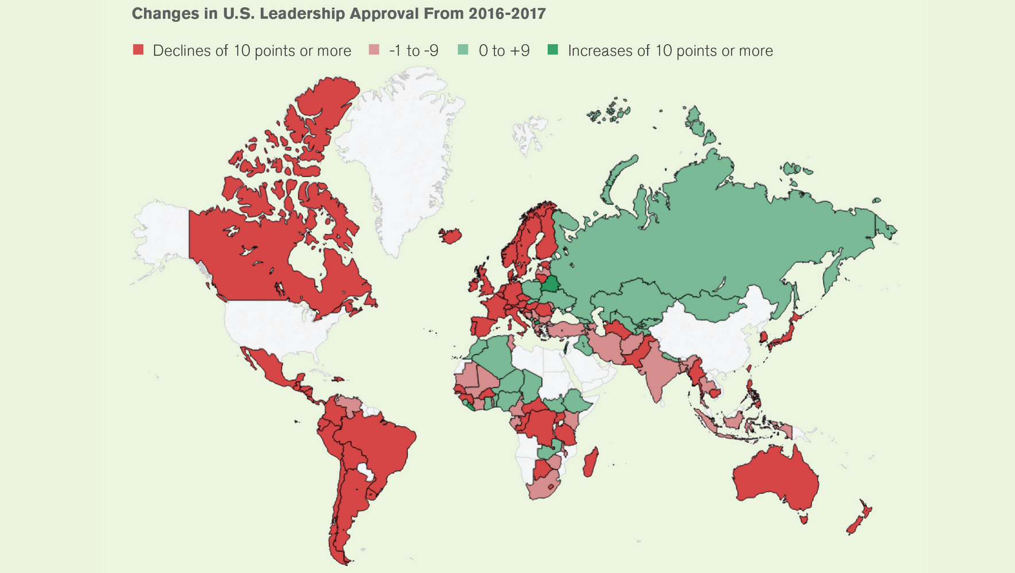
Should we care about U.S. global approval rating?

Slide 10
Rational Choice and Motivated Reasoning
How do individuals and groups interpret information and form opinions?
Rational choice: people take in all the information available and update their assessment.
Bounded rationality: prior belief + incoming information = update our assessment.
Motivated reasoning: prior beliefs, stereotypes, and identity used to overrule and dismiss incoming information. Data uses to confirm (not test) prior beliefs.
Identity-protecting cognition.

Slide 11
Research Question:
Herrmann’s argument tries to explain when emotions will fire, for whom, and how that will shape the formation of conscious beliefs.
Based on social identity theory: people derive some of who they are from attributes they personally possess and part of who they are from the groups they belong to (Brown 2000; Tajfel 1981).

Slide 12
Hypotheses:
Attachment and Interpretation
H1: Attachment to the nation associates positively with more intense emotional appraisals of the international situation. In other words, as attachment increases so does the judgment that potentially threatening situations represent bigger problems.
International Trust
H2: As national attachment increases so will the inclination to attribute defensive intentions to countries that are liked and aggressive intentions to countries that are disliked.
Action & Policy
H2a: As national attachment increases so will the inclination to punish countries that are disliked and to forgive those that are liked when the two are doing the same thing that can be seen as violating a norm.

Slide 13
Results:
It appears that national attachment as well as chauvinism motivate people to interpret and react to the same act differently depending on the country involved.
That is because the countries evoke different emotions that motivate the construction of beliefs that allow the observer to apply normative standards in different ways while believing they are abiding by these standards.
Likewise, beliefs about situations and what is normatively appropriate follow as much from attachment to the nation and the emotional desires this gives rise to as they do from the norm itself.

